Slide 1
Data 621 Project 4
Joby John & Jun Pan
April 18, 2019

Slide 2
Your objective is to build multiple linear regression and binary logistic regression models on the training data to predict the probability that a person will crash their car and also the amount of money it will cost if the person does crash their car.
Overview In this homework assignment, you will explore, analyze and model a data set containing approximately 8000 records representing a customer at an auto insurance company. Each record has two response variables. The first response variable, TARGET_FLAG, is a 1 or a 0. A "1" means that the person was in a car crash. A zero means that the person was not in a car crash. The second response variable is TARGET_AMT. This value is zero if the person did not crash their car. But if they did crash their car, this number will be a value greater than zero. Your objective is to build multiple linear regression and binary logistic regression models on the training data to predict the probability that a person will crash their car and also the amount of money it will cost if the person does crash their car. You can only use the variables given to you (or variables that you derive from the variables provided). Below is a short description of the variables of interest in the data set:

Slide 3
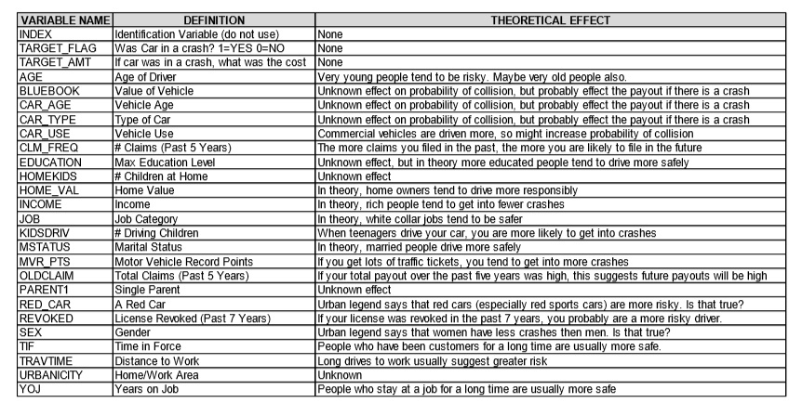
Data Set Information

Slide 4
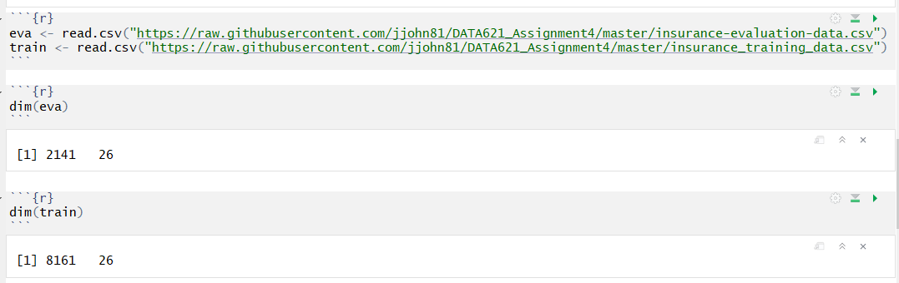
Data Exploration
Databases were loaded from github repository:
https://github.com/jjohn81/DATA621_Assignment4
In train dataset, there were 8161 observers and 26 variables.
In evaluation dataset, there were 2141 observers and 26 variables.

Slide 5
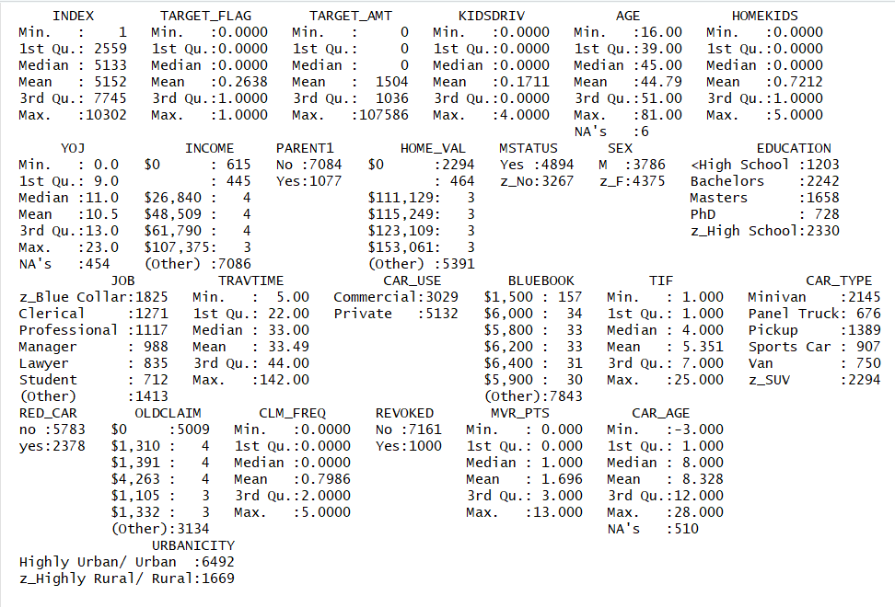
Summarize Train Data

Slide 6
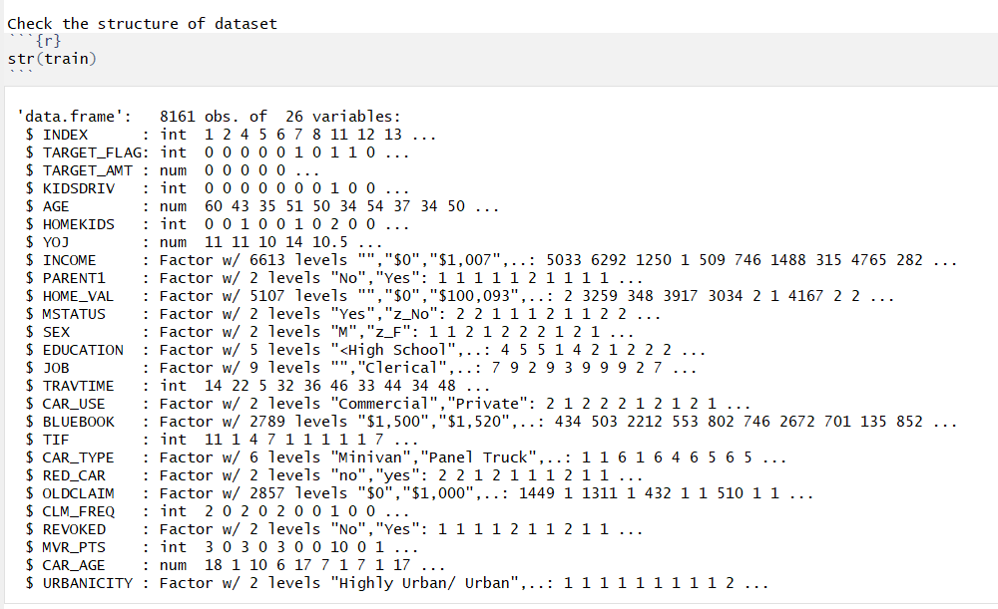

Slide 7
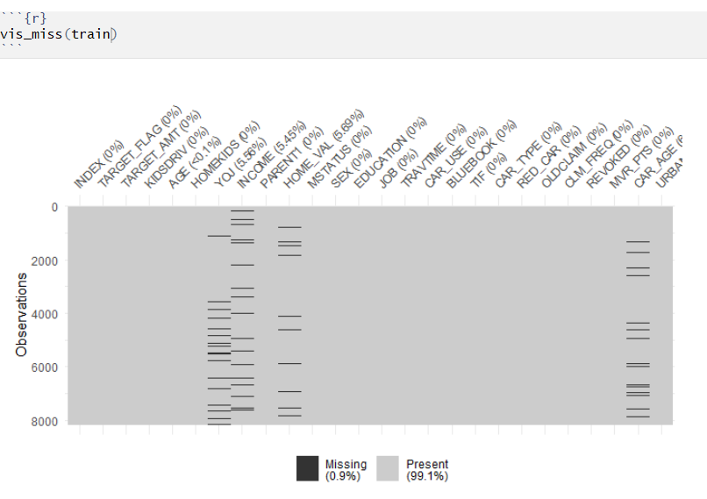
Check Missing Values

Slide 8

Detailed information about NA

Slide 9
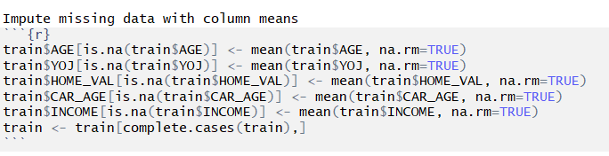
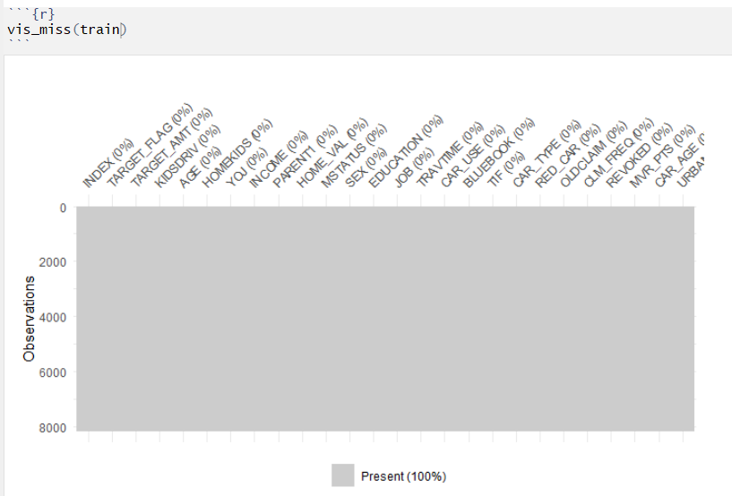
Impute missing values with mean
No Missing
Values

Slide 10
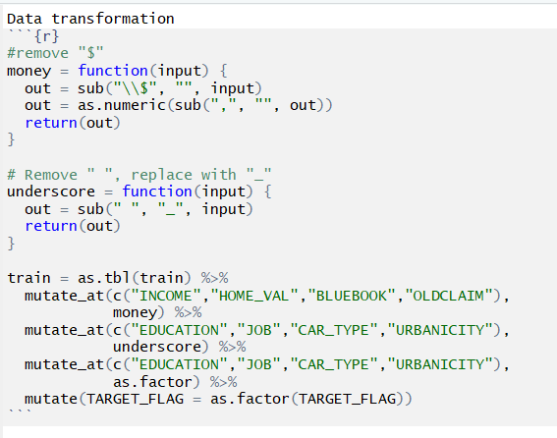
Transform Data
1: remove $ sign from INCOME, HOME_VAL, BLUEBOOK, OLDCLAIM;
2: replace " " with underscore "_" of variables : EDUCATION, JOB, CAR_TYPE, URBANICITY
3: change it as factors for above variabls plus TARGET_FLA

Slide 11
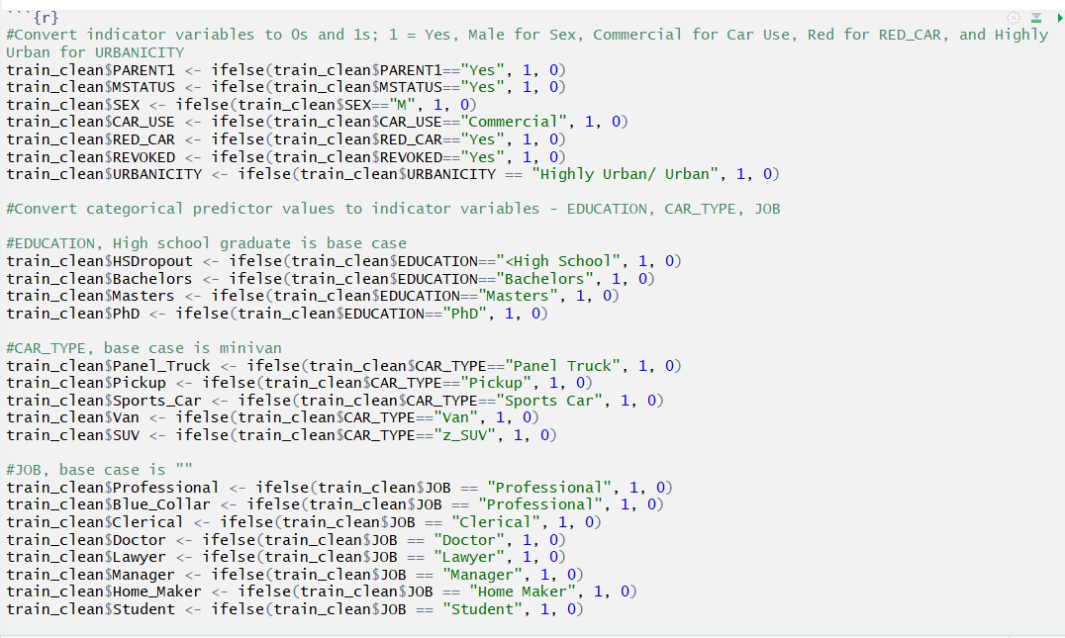
Convert Variables

Slide 12
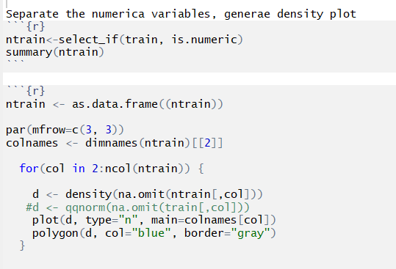
Density Plot of Numerical Variables

Slide 13
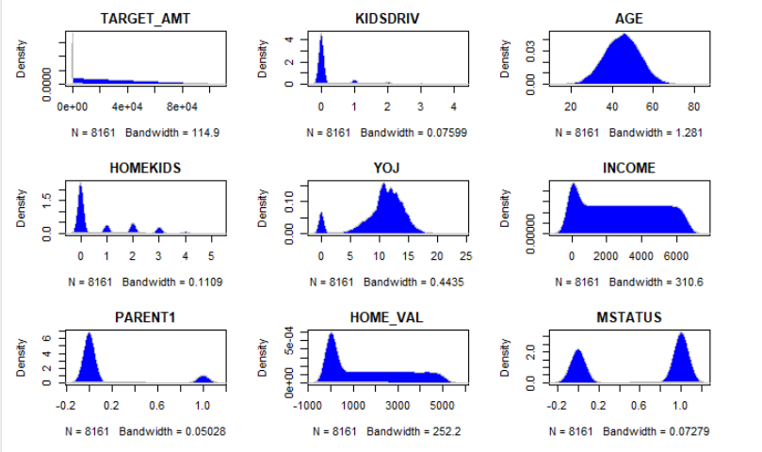

Slide 14
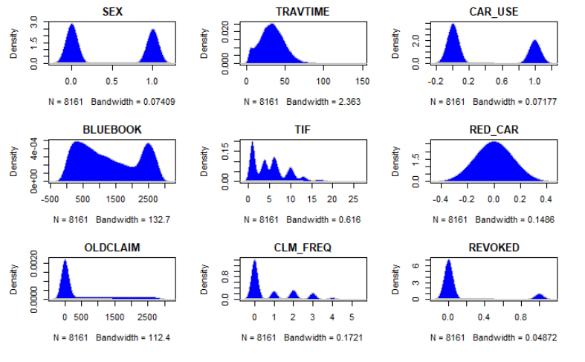

Slide 15
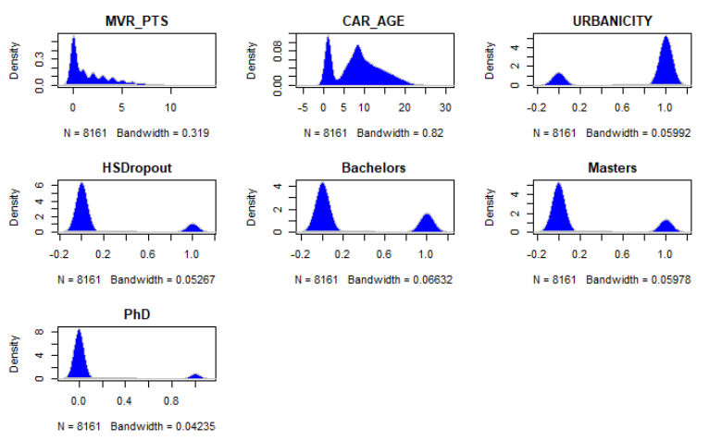

Slide 16
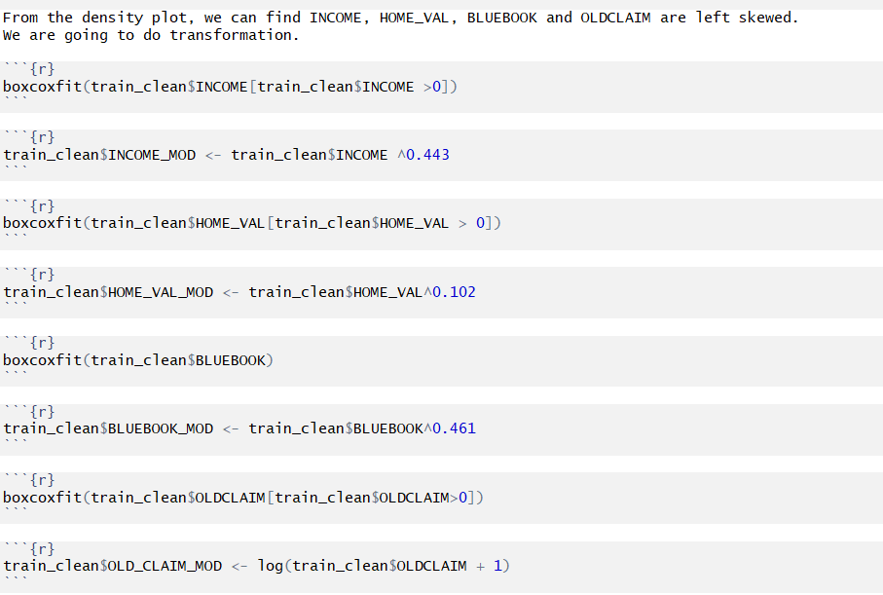
Modify Skewed Variables

Slide 17
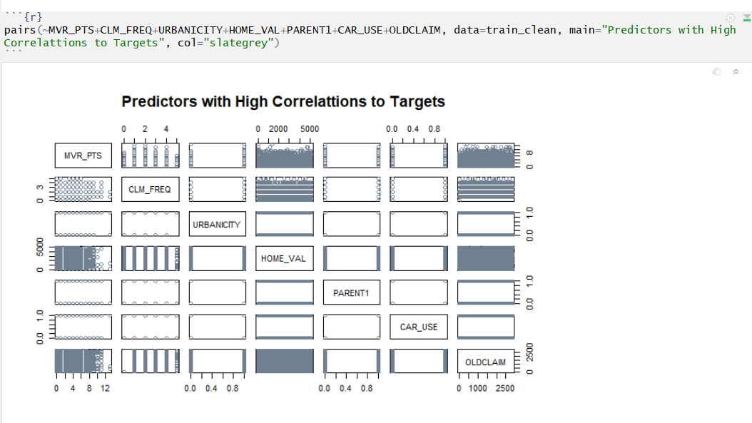

Slide 18
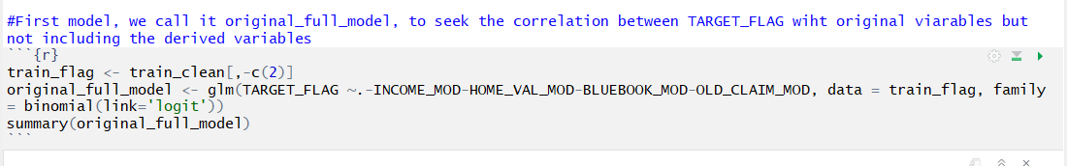
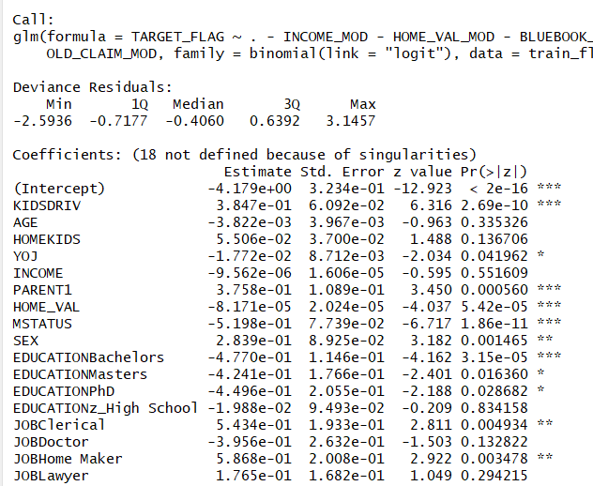
Original Full Model

Slide 19
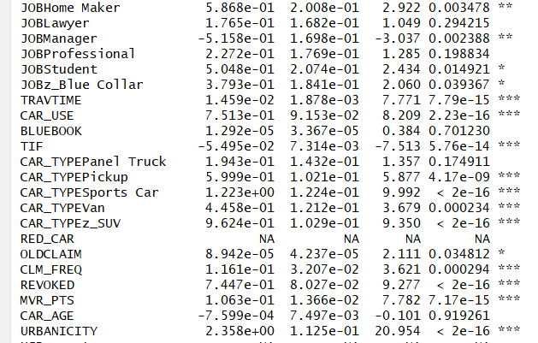
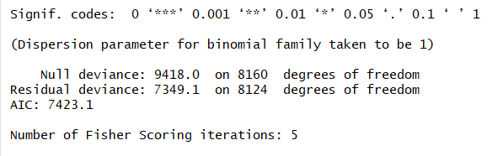

Slide 20
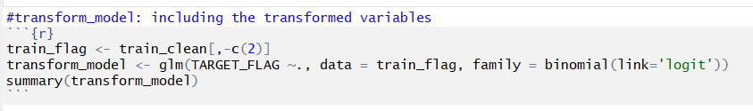
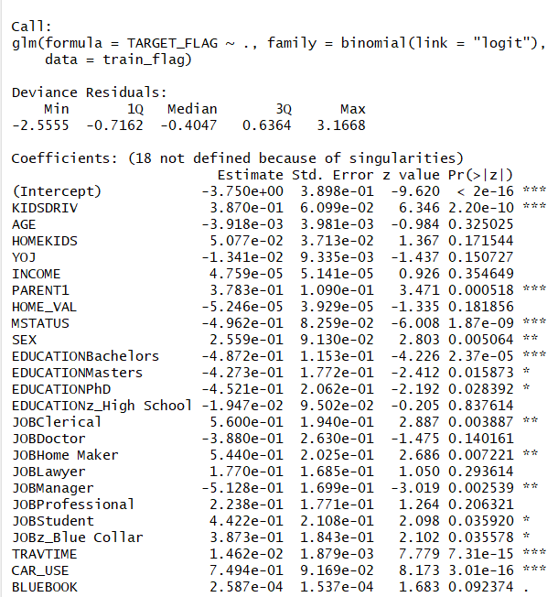
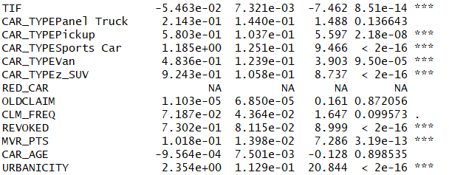
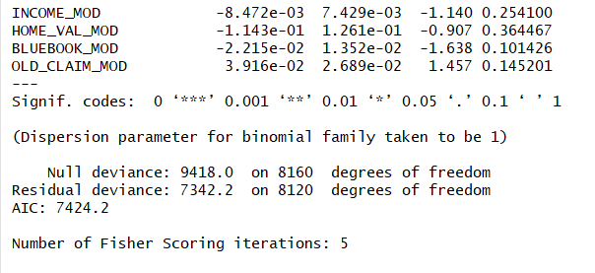
Transformed Model

Slide 21
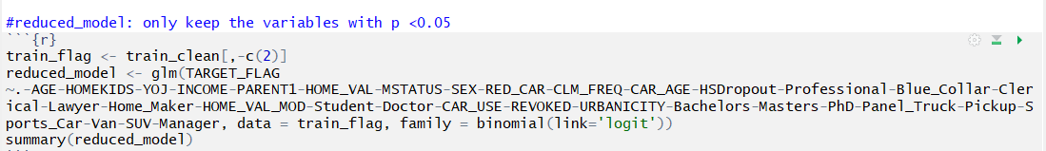
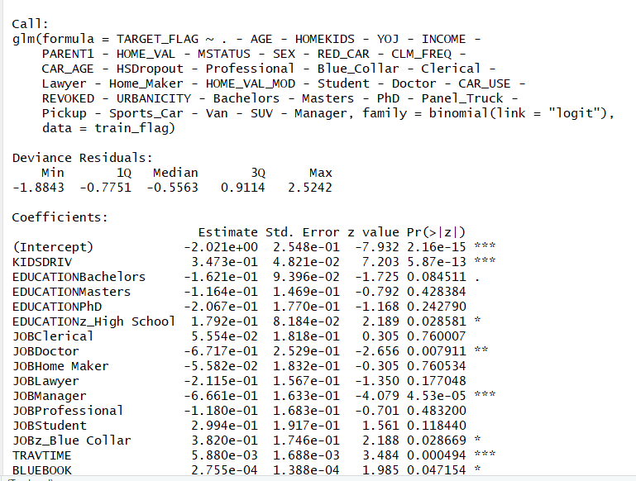
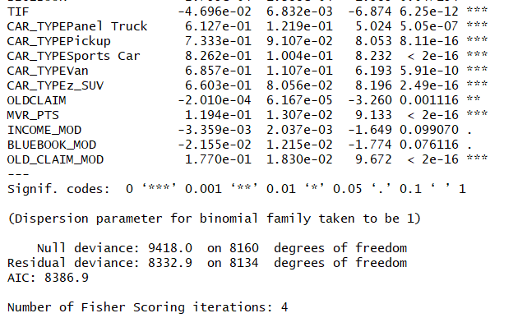
Reduced Model

Slide 22
I would like to select Reduced Model for Binary Logistic Regression models. The AIC and residual deviance for this model seemed to give the best values that would be suited for the prediction. Below is the ROC curve for model5 and to me it looks good. So i would like to proceed with Reduced Model.

Slide 23
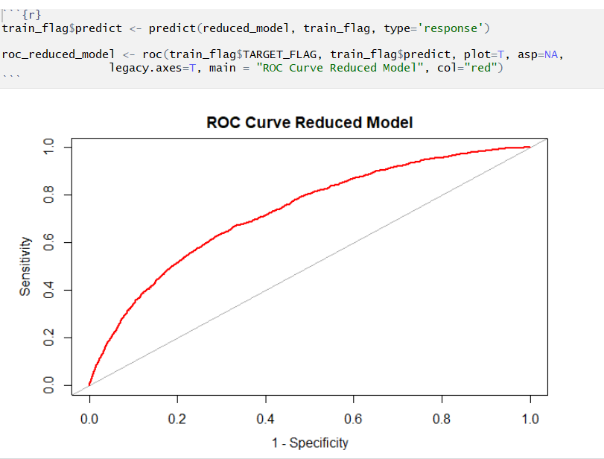
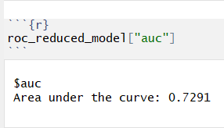
ROC Curve & AUC

Slide 24
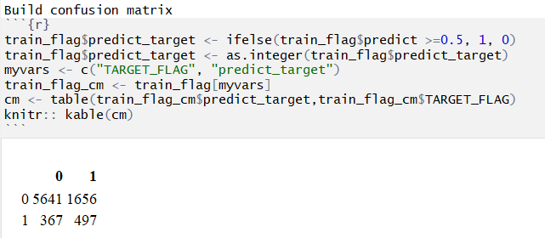
Build Confusion Matrix

Slide 25
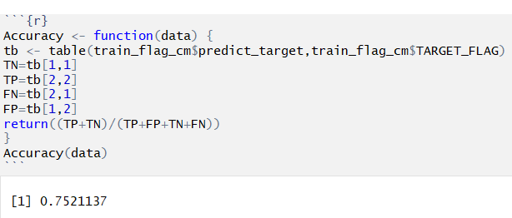
Accuracy

Slide 26
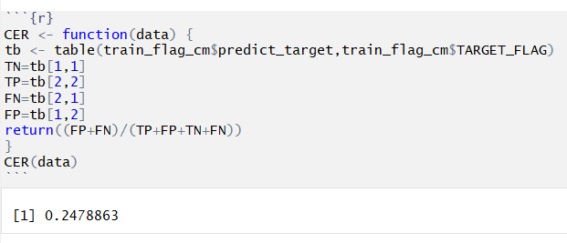
CER

Slide 27
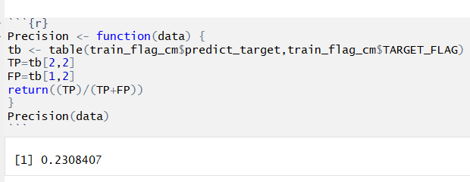
Precision

Slide 28
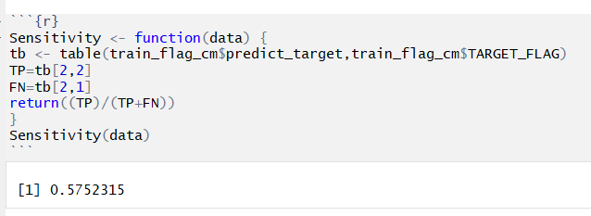
Sensitivity

Slide 29
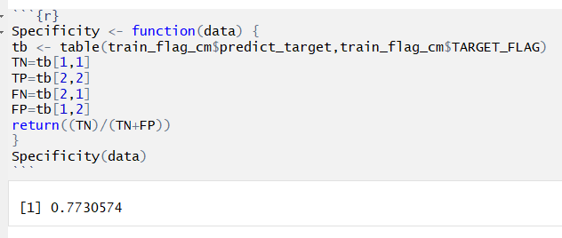
Specificity

Slide 30
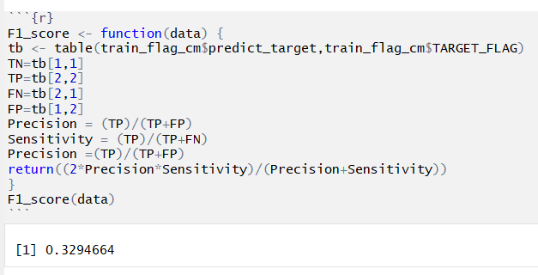
F1 Score

Slide 31
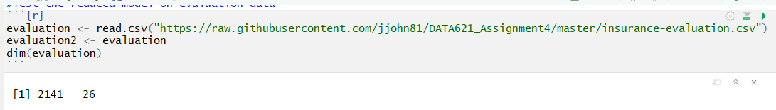
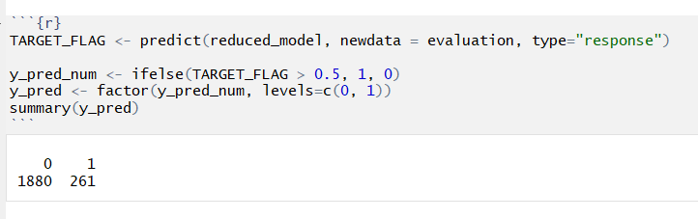
Test Reduced Model on Evaluation Data
https://github.com/jjohn81/DATA621_Assignment4
http://rpubs.com/Jun_Pan43/488928

